Slide 1

Deep learning with Neural Networks
Dense Neural Networks
Backpropagation
Regularization
Normalization layers
Learning rates
Feature explainability
Alejandro Lancho Serrano, alancho@ing.uc3m.es
Material original por Pablo Martínez Olmos

Slide 2
Fundaments of Neural Networks

Slide 3
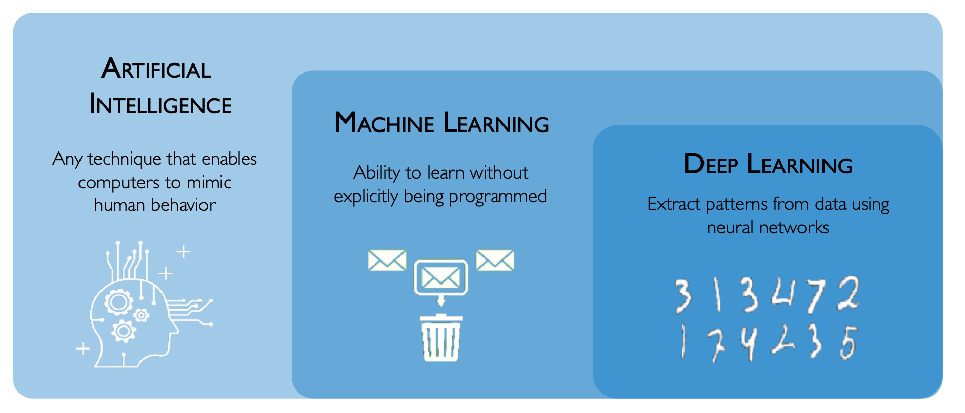
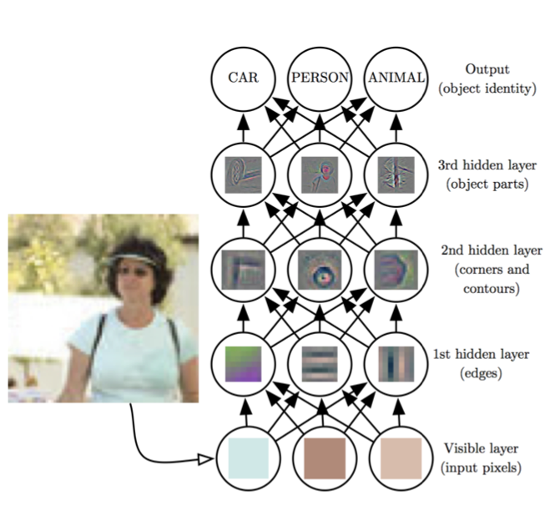
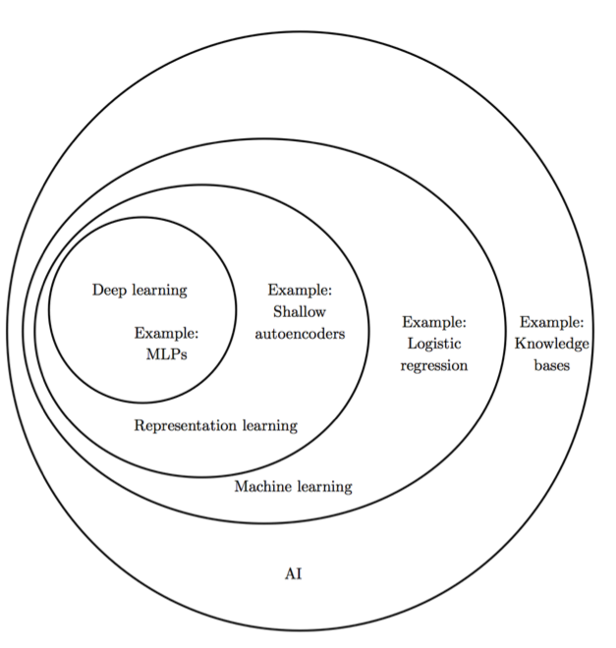
What is Deep Learning?
Source: Deep Learning, Good Fellow et al. 2017

Slide 4
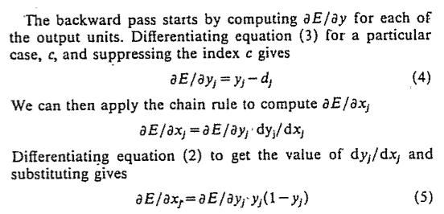
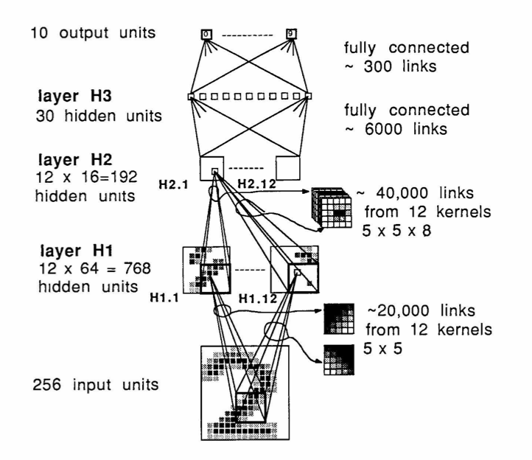
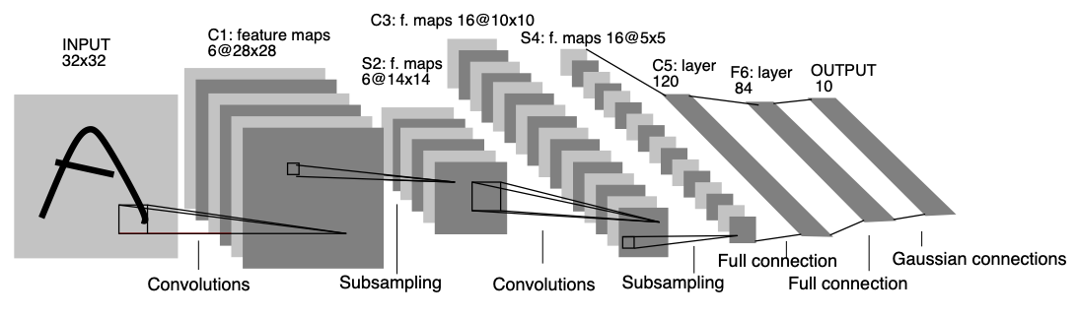
Neural Networks Revisited
Most elements of network architecture employed as early as the mid-1980’s
A History of Deep Learning (link)
Learning representations
by back-propagating errors
Rumelhart, Hinton, Williams (1986)
Backpropagation applied to Handwritten Zip Code Recognition
LeCun et al. (1989)
Gradient-Based Learning applied to Document Recognition
LeCun, Bengio, Haffner (1998)

Slide 5
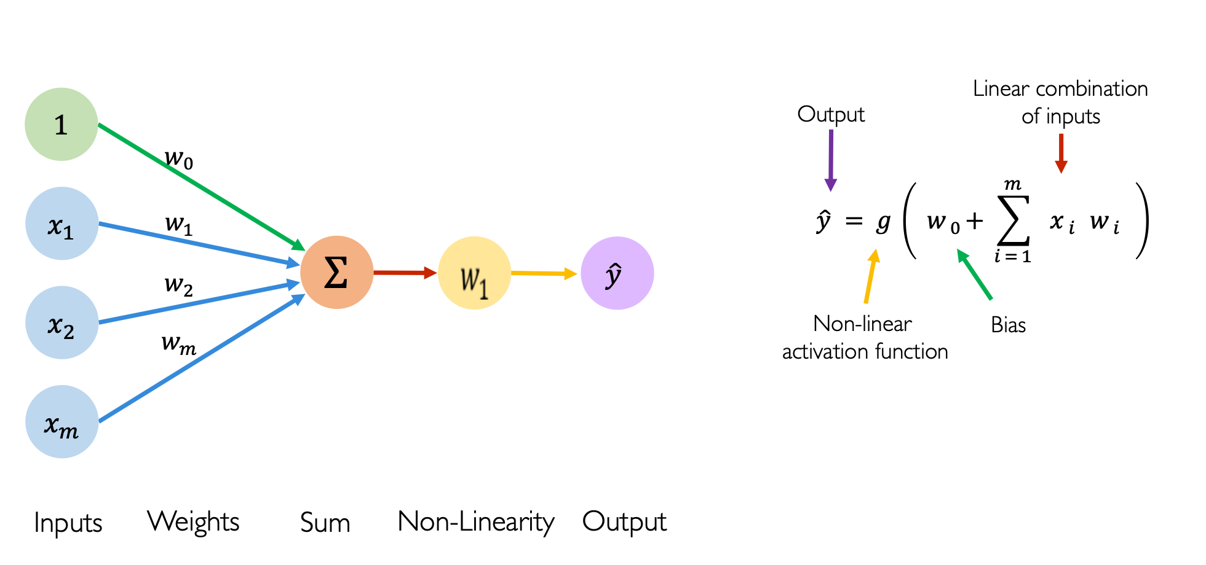
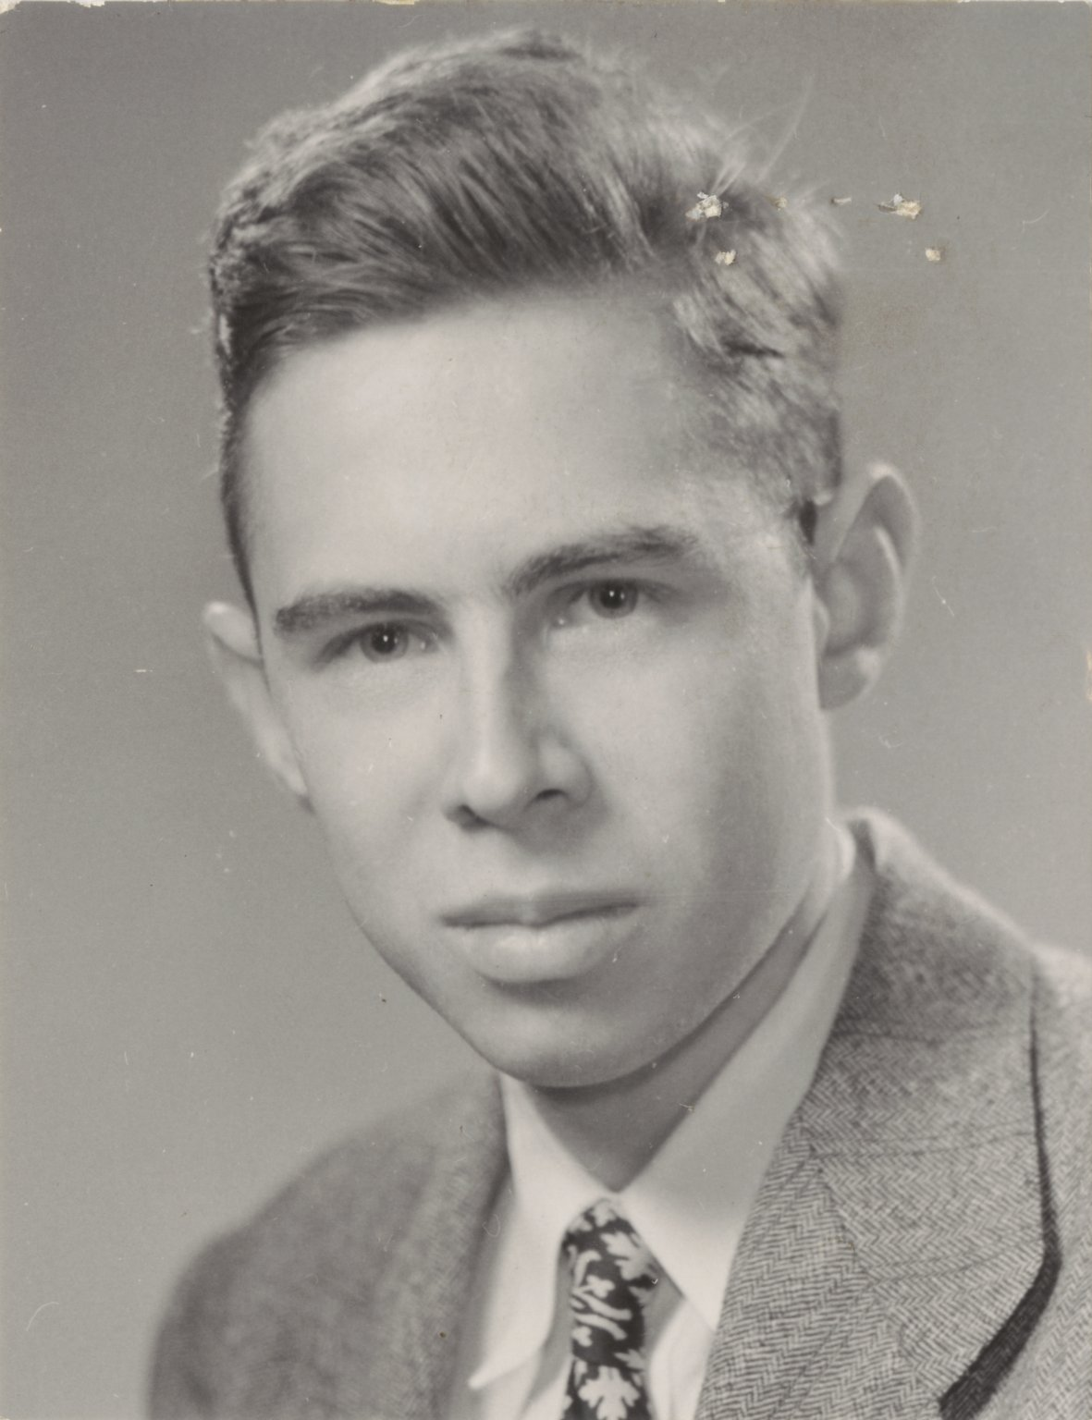
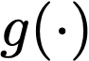
The Perceptron: The structural building block of deep learning
Wikipedia Entry for Frank R.

Slide 6
Dense Neural Networks

Slide 7
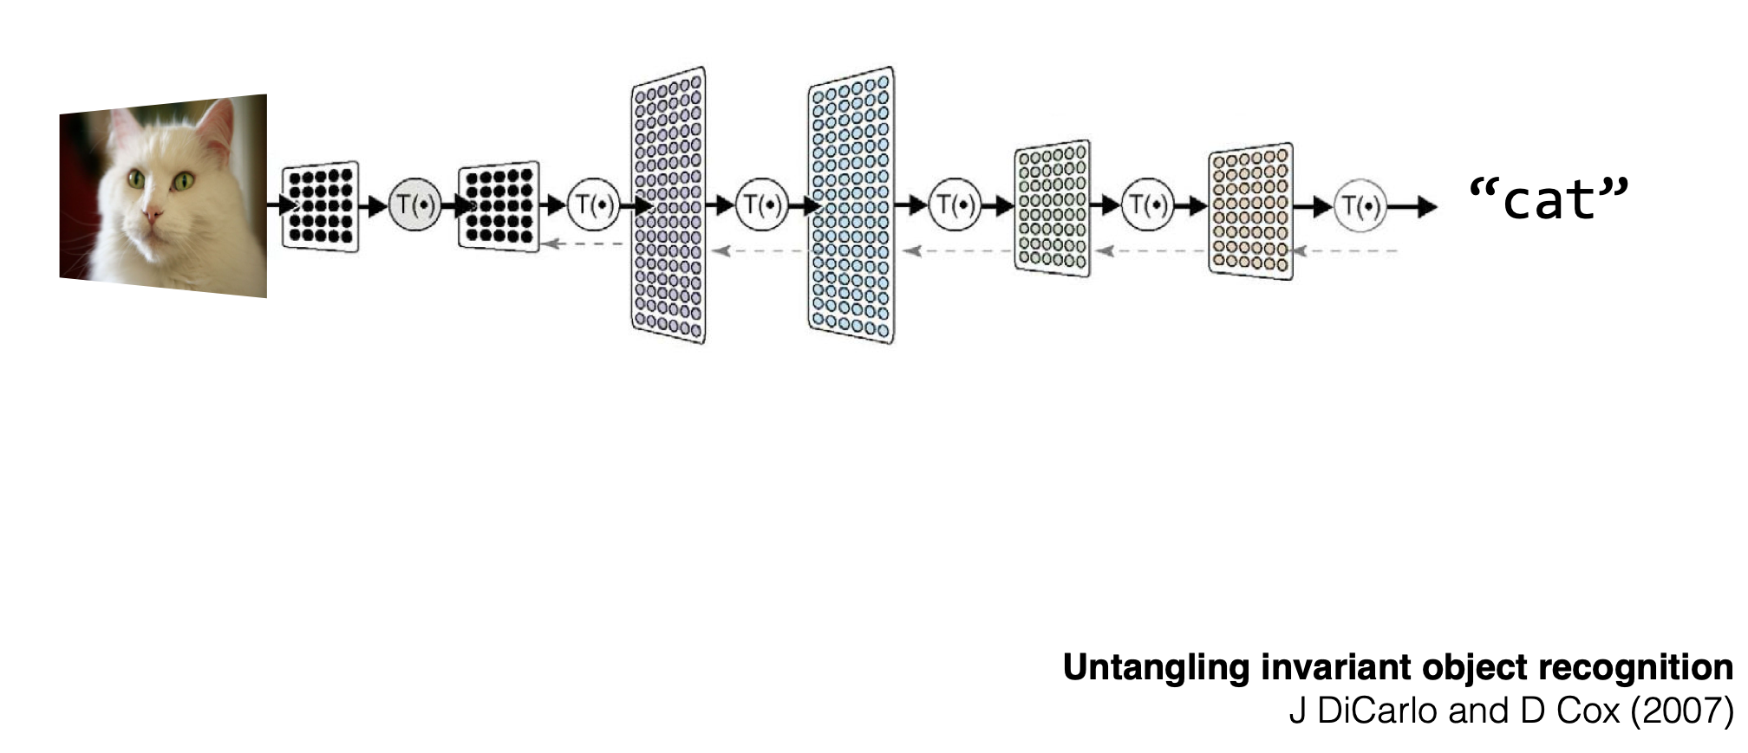
Deep learning = artificial neural networks
Hierarchical composition of simple mathematical functions
Notes:
Very tailored originally to classification computer vision tasks

Slide 8
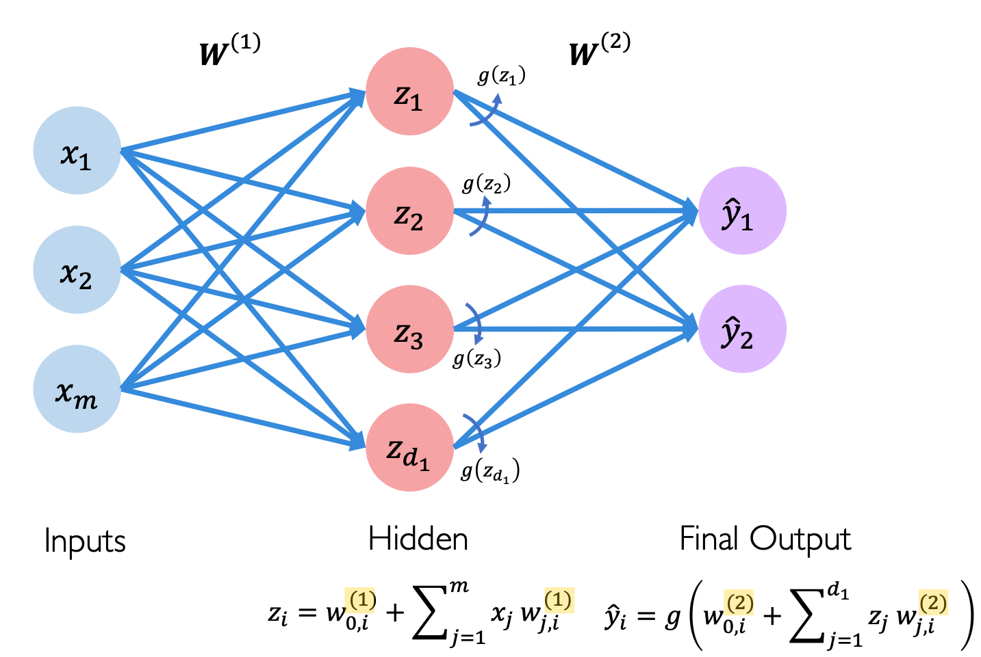
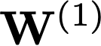
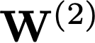
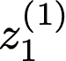
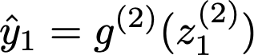
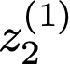
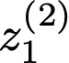
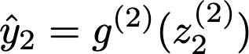
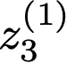
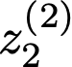
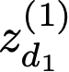
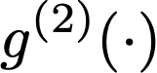
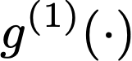
A Neural Network with two layers

Slide 9
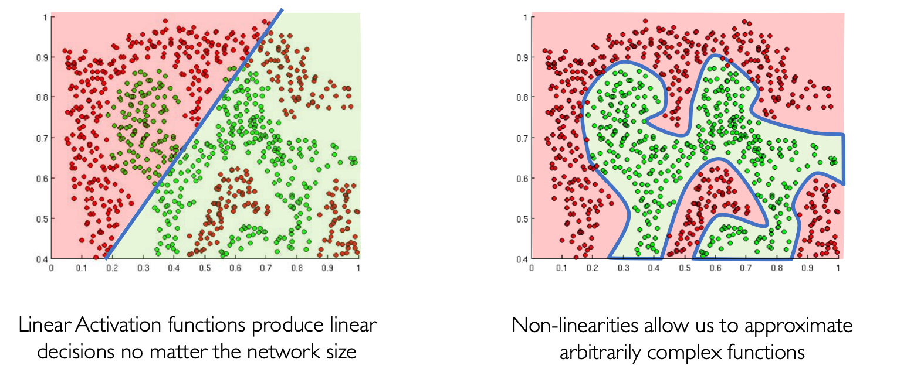
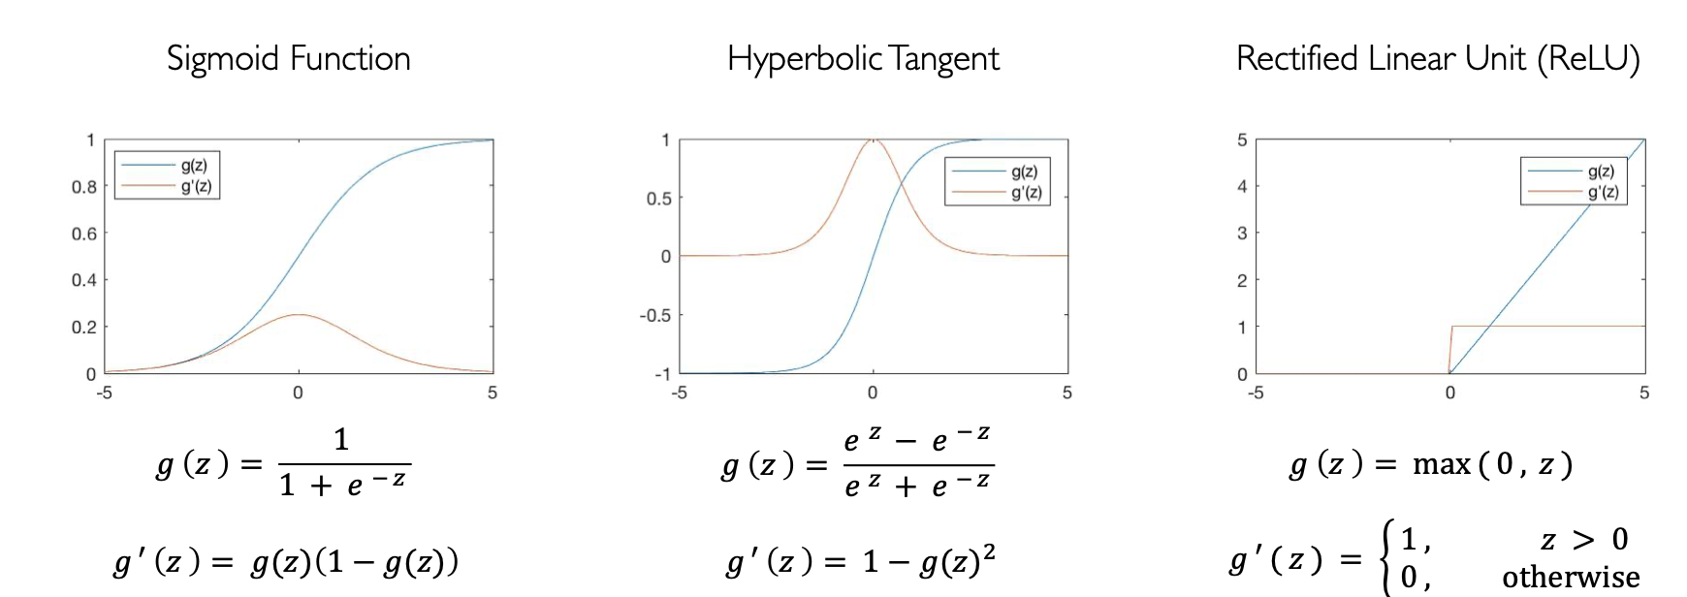
Activation Function
The purpose of activation functions is to introduce non-linearities into the network
Notes:
Importantly, those activation functions that became popular were easy to differientiate due to the SGD algorithm used to optimize DNNs! Will see later why when studying more in depth SGD with backprop.

Slide 10
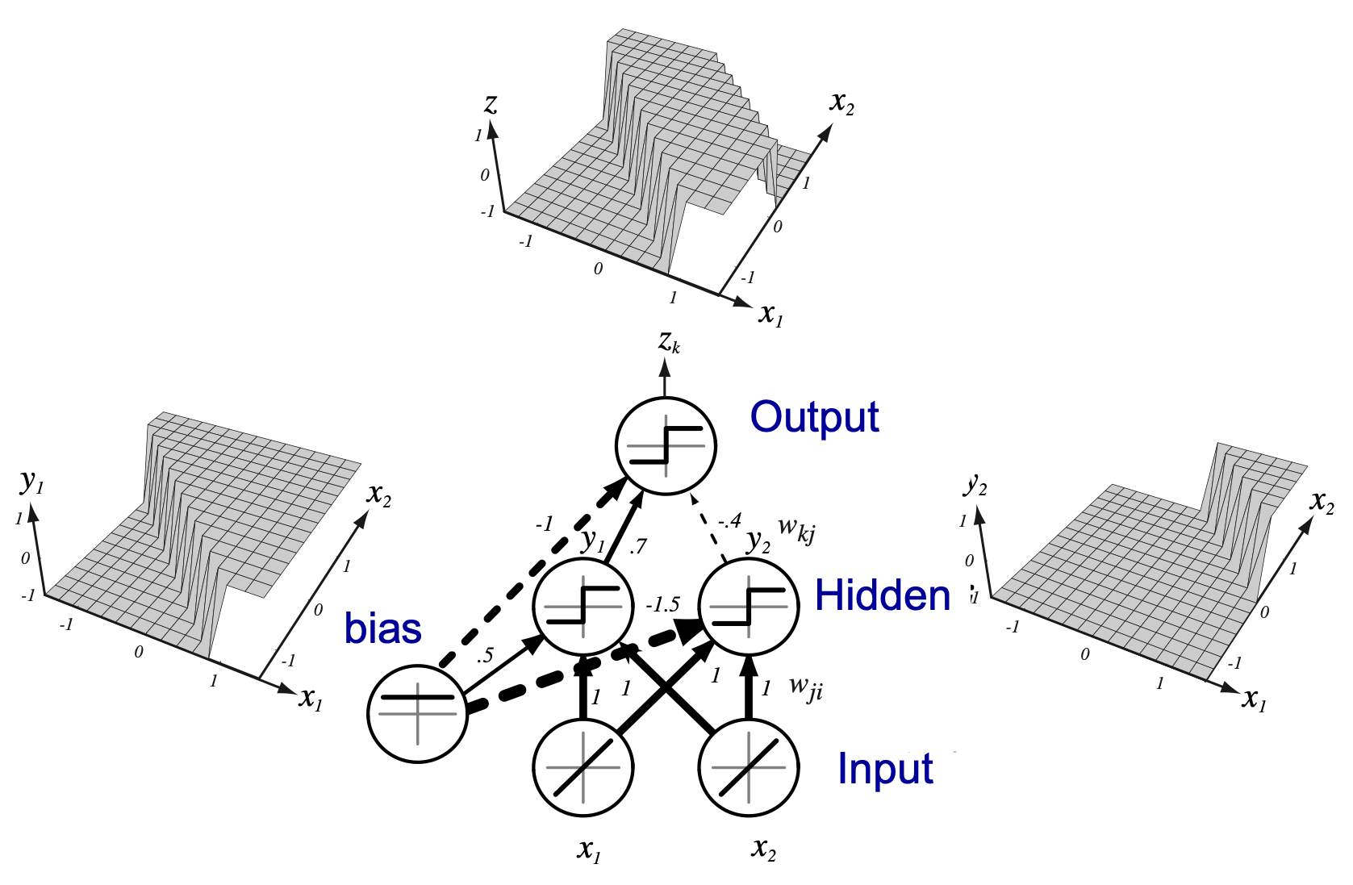
A Neural Network with two layers

Slide 11

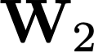
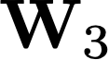
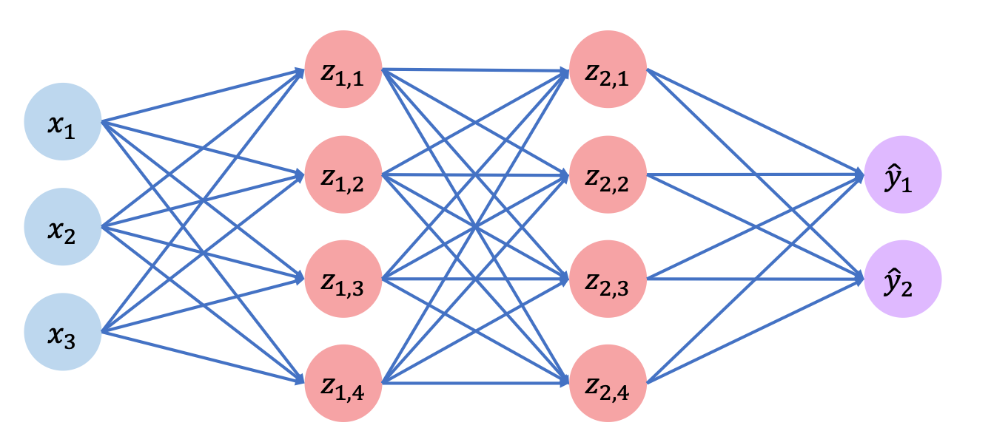
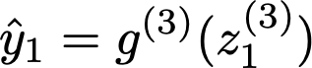
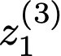
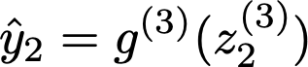
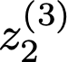
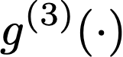
A Neural Network with three layers

Slide 12
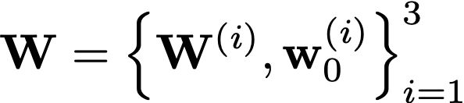
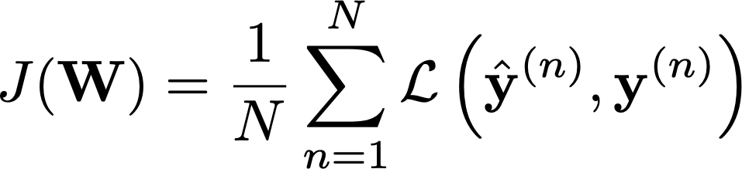
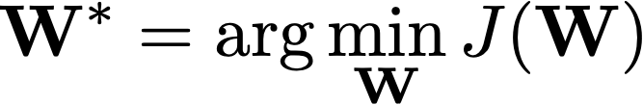
Training Neural Networks (Supervised task)
Parameter Set
Empirical Loss
Model Training

Slide 13
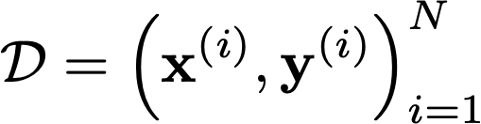
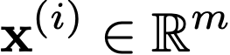
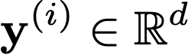
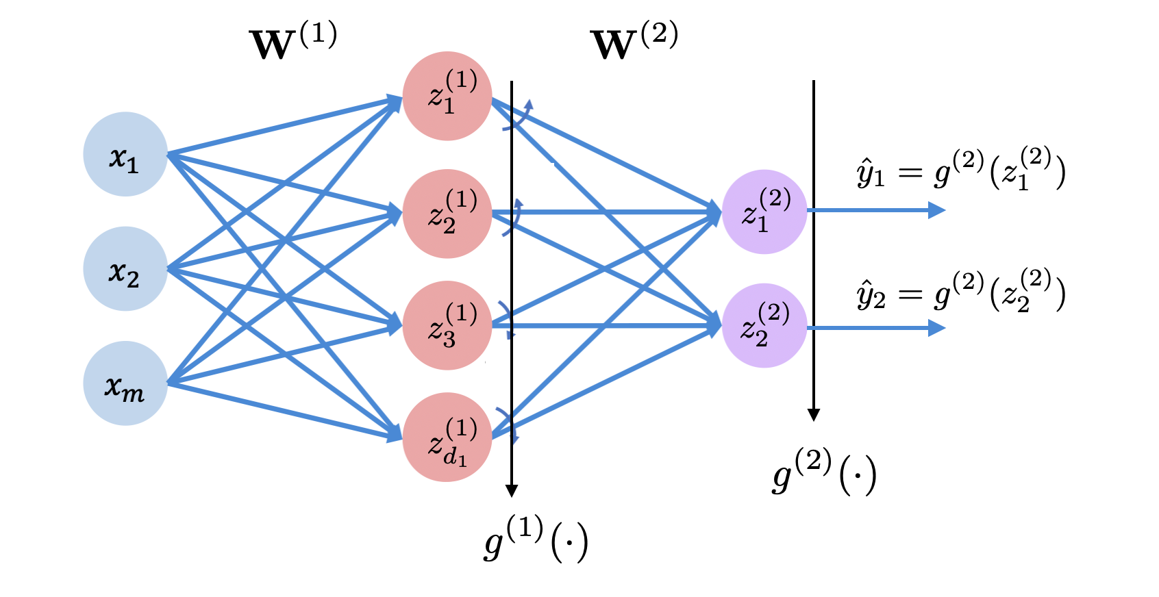
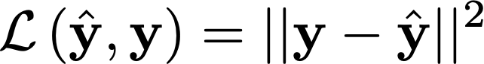
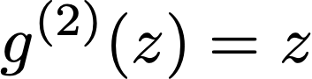
Loss Function (Supervised task)
Multi-output Regression
Squared loss
Linear activation
What if the output y is positive-real valued?
Notes:
Check the answer to the red question. My guess now is that maybe the linear activation function is not as good as a relu? But maybe we go more towards the squared loss? Or simply a link to justify the activation function in the next slide?

Slide 14
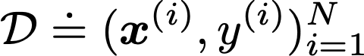
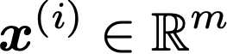
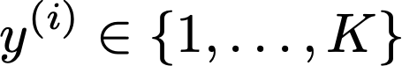
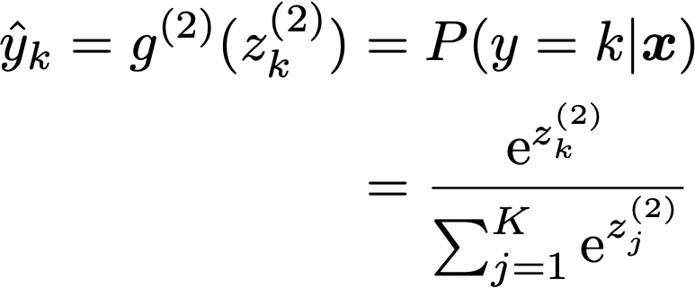
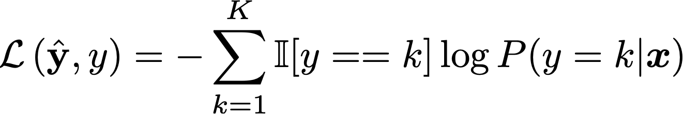
Loss Function (Supervised task)
Classification
Convert the network output to a probability distribution with the softmax function
Softmax
Cross Entropy Loss Function
Notes:
The training procedure looks like the logistic regression. The additional difficulty is dealing with layers that depend sequentially on each other and their optimization. This will be solved with the backprop algorithm.
Why two outputs on this example?

Slide 15
Training NNs

Slide 16
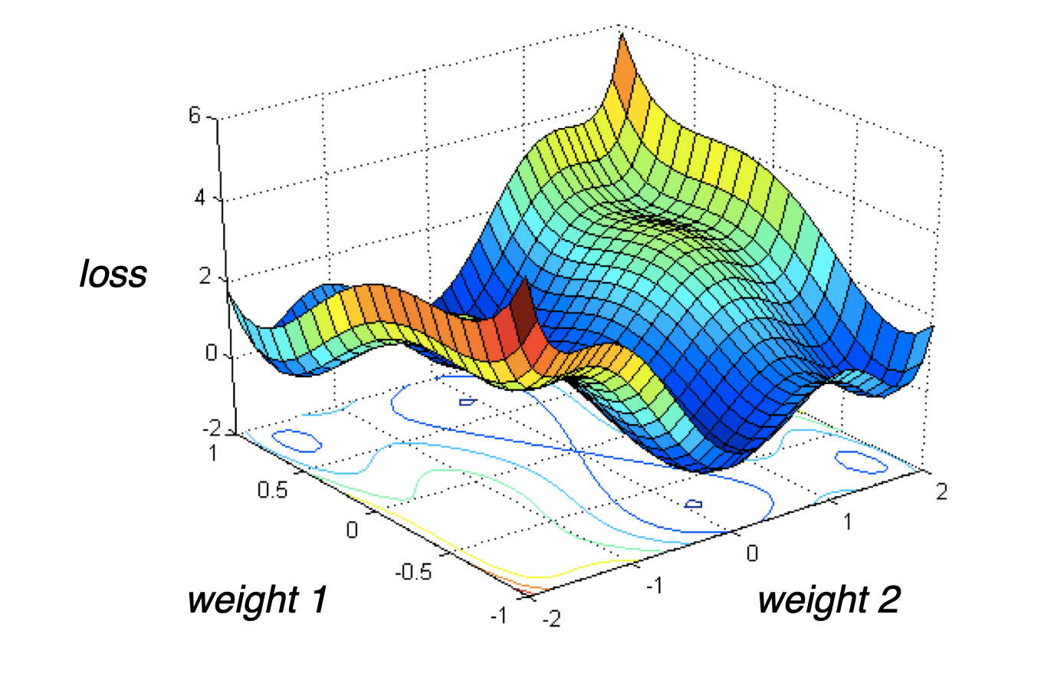
Optimization is highly non-convex …
Note that deep networks operation in O(1M) dimensions!

Slide 17
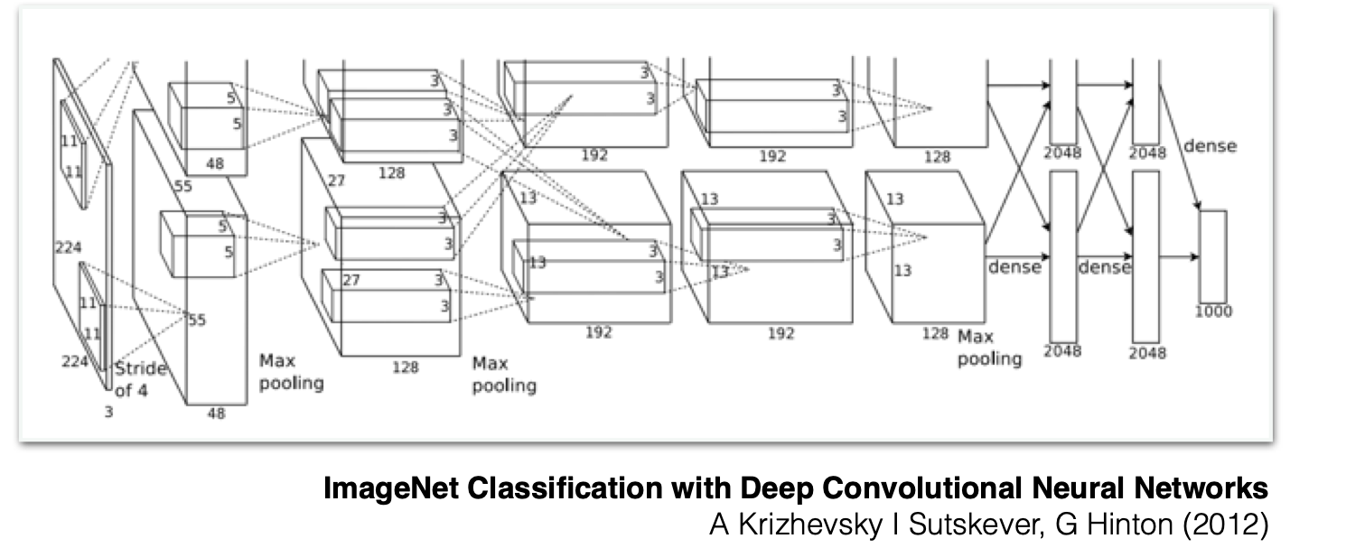
Brutally simple but engineering matters
Deep CNN (AlexNet) won 2012 ImageNet classification contest
60 Millions Parameters
Exploit data correlation
Achieving scale in compute and data is critical
Notes:
ImageNet:
ImageNet is a massive dataset with over 14 million images covering nearly 22,000 categories, with a widely-used 1,000-class subset that is employed in various computer vision benchmarks. The dataset has played a crucial role in advancing deep learning and computer vision research. (150-200GB in disk)
Some info about the ImageNet challenge before AlexNet:
The ImageNet Large Scale Visual Recognition Challenge (ILSVRC) officially started in 2010. This was the first year that the competition was held, and it quickly became one of the most significant benchmarks for measuring progress in computer vision.
ILSVRC Timeline Before 2012:
2010: The first ILSVRC was held. The winning method was developed by the NEC-UIUC team, which used a combination of traditional feature extraction techniques like SIFT, with a spatial pyramid matching framework and linear SVMs as the classifier.
2011: The challenge continued, and the XRCE (Xerox Research Centre Europe) team won using Fisher Vectors combined with SIFT descriptors and linear SVMs. This method improved on the previous year by providing a more powerful representation of the image features.
Summary:
2010: First ILSVRC competition, dominated by traditional computer vision techniques like SIFT, BoVW, and SVMs.
2011: Fisher Vectors and SVMs became the leading approach.
These methods, though cutting-edge at the time, were significantly less powerful than the deep learning approaches that began to emerge in the early 2010s. When AlexNet was introduced in 2012, it dramatically outperformed the previous methods, reducing the top-5 error rate from around 25% (achieved by the 2011 winners) to 16.4%, signaling the beginning of the deep learning era in computer vision.
1. Handcrafted Features:
SIFT (Scale-Invariant Feature Transform) and HOG (Histogram of Oriented Gradients) were popular feature extraction methods. These methods involved detecting key points or edges in images and then describing them in a way that was invariant to transformations like scaling or rotation.
2. Bag of Visual Words (BoVW):
After extracting features using methods like SIFT or HOG, these features were typically quantized into a "visual vocabulary." The image was then represented as a histogram of visual words, which was then used as input to a classifier.
3. Support Vector Machines (SVMs):
SVMs were commonly used as the classifier on top of the handcrafted features. These models are effective in high-dimensional spaces and were state-of-the-art for many image classification tasks.
4. Pyramid Match Kernel:
This method extended the traditional bag-of-words model by matching features at multiple resolutions, capturing more spatial information about the arrangement of features within an image.
5. Fisher Vectors:
An improvement over BoVW, Fisher Vectors (FV) capture more information by modeling how features differ from a Gaussian Mixture Model (GMM) fitted to the training data. FV representations were more compact and powerful compared to BoVW histograms.

Slide 18




… but training is brutally simple (we assume we never get to the global optima)
Gradient Descent
Algorithm
Initialize weights randomly
Loop until convergence:
3. Compute gradient
4. Update Weights
5. Return weights
Check out this excellent post about initialization!

Slide 19
… but training is brutally simple (we assume we never get to the global optima)
Gradient Descent
Algorithm
Initialize weights randomly
Loop until convergence:
3. Compute gradient
4. Update Weights
5. Return weights

Slide 20
Computing gradients efficiently: backpropagation
A deep NN can contain millions of parameters
Gradients cannot be computed individually for parameter, there must be some way of “reusing” computations
Backpropagation is the key to understand why NNs have such a particular structure:
A multi-variate linear operator (efficiently implemented in HW)
Followed by element-wise non-linear functions
Thanks to this structure, with Backpropagation we evaluate gradients from the top (output) of the network to the bottom (input) by reusing computations.
Cost of computing gradients ~ cost of evaluating the NN output for a given input

Slide 21






Example for a 2 layer NN with linear outputs (regression)
Backpropagation
general formula
Notes:
For next year maybe, it would be good to enlarge the diagram and write also the weights? Also, fix notation issues
In any case, the main idea of backpropagation is that we can reuse the deltas in computing gradients backwards until reaching the input.
Also, it is good in memory usage as, if in the forward pass, we store the weights of course, and the inputs and outputs of each neuron. Having these values allow us to obtain the deltas in a very efficient way, and therefore backpropagate and obtain all the needed gradients.

Slide 22










Stochastic Backpropagation
Assume an M-layer MLP
Very costly for massive datasets!
Stochastic Gradient Descent (SGD)
Select at random a mini batch of data at every SGD iteration
Parallelizable! Very efficient in GPUs

Slide 23

Gradient Descent
Adaptive Learning Rates
Algorithm
Initialize weights randomly
Loop until convergence:
3. Compute (noisy) gradient
4. Update Weights
5. Return weights
Step Size can be made larger or smaller
depending on:
how large gradient is
how fast learning is happening
size of particular weights
etc...
Momentum, Adagrad, Adam, RMSProp, … (Check out this post)

Slide 24
How to improve generalization?
Notes:
Here starts class 3 in MIAA (double check)

Slide 25

Reduce Overfitting & Improve Regularization Performance
sebastianraschka.com

Slide 26

Avoid Overfitting with More Data
sebastianraschka.com

Slide 27

Avoid Overfitting with Data Augmentation
Original
Randomly augmented
Link to Code Example
sebastianraschka.com

Slide 28
Regularization: Early Stopping
Remember to split dataset into (training, validation, test)
Use validation accuracy for tuning
Use test only at the end (when we have selected our best model)
Dataset
Training
Validation
Test

Slide 29



Model Selection
Train your model on the training set
For model selection, use a validation set
Hyper-parameter search: hidden layer sizes, number of layers, learning rate, number of iterations/epochs, …
Estimate generalization performance using a test set

Slide 30
Regularization

Slide 31
Regularization Goal: Reduce Overfitting
Usually achieved by reducing model capacity and/or reducing the variance of preditions
Common regularization techniques for DNNs:
Early Stopping
L1/L2 regularization (norm penalties)
Dropout

Slide 32


Regularization: Early Stopping
To select the number of epochs, stop training when validation set error increases (with some look ahead)
Good stopping point!
Loss:

Slide 33
L1 & L2 Regularization
A “weight shrinkage” or a “penalty against complexity”
L1 regularization => LASSO Regression
L2 regularization => Ridge Regression
Let’s focus on L2 regularization:
hyperparameter
$$+\frac{λ}{N}\underset{j}{∑}ω_{j}^{2}$$
L2-regularization:
where:
$$\underset{j}{∑}ω_{j}^{2}=∥w∥_{2}^{2}$$

Slide 34

L2 Regularization Effect on Decission Boundaries
Large regularization penalty => high bias
Low regularization penalty => high variance
Good compromise
1.
2.
3.

Slide 35
L2 Regularization in Neural Networks
$$+\frac{λ}{N}\overset{L}{\underset{l=1}{∑}}∥w^{l}∥_{F}^{2}$$
where
$$∥w^{l}∥_{F}^{2}$$
is the Frobenius norm (squared)
sum over layers
$$∥w^{l}∥_{F}^{2}=\underset{i}{∑}\underset{j}{∑}(ω_{i,j}^{l})^{2}$$

Slide 36



Regularization: Dropout
During training cripple neural network by removing hidden units stochastically
Randomly set some activations to 0
Typically ‘drop’ 50% of activations in layer
Forces network to not rely on any 1 node
In validation & test we use the
full network!

Slide 37
Dropout: Possible Interpretation
Network will learn not to rely on specific connections too heavily
We’ll consider more connections
Weight values more “spread-out” (similar to L2 norm)
Ensemble method interpretation:
Different model for each minibatch (weight-sharing => regularizes)
Infernce can be seen as a geometric average of those models

Slide 38
Normalization Layers

Slide 39
Internal shift
Training Deep Neural Networks is complicated by the fact that the distribution of each layer’s inputs changes during training, as the parameters of the previous layers change
We refer to this phenomenon as internal covariate shift
This slows down the training by requiring lower learning rates, and makes it notoriously hard to train models with saturating nonlinearities

Slide 40

Batch Normalization
By fixing the distribution of the layer inputs as the training progresses, we expect to improve the training speed
Batch Normalization performs input normalization in a way that is differentiable and does not require the analysis of the entire training set after every parameter update
Normalize each scalar feature independently
Scale the normalized input with trainable parameters

Slide 41







Batch Normalization
Mini-batch of size M
Mini-batch mean
Mini-batch variance
Input to the non-linear activation
Normalize
Scale and shift

Slide 42


Batch Normalization
During evaluation, we normalize according to the whole validation/test datasets. parameters are fixed!

Slide 43


Layer Normalization
The effect of batch normalization is dependent on the mini-batch size
It is not obvious how to apply it to recurrent neural networks.
In layer normalization, we normalize the sum of inputs in a layer using a single case.

Slide 44




Layer Normalization
Batch Normalization
Layer Normalization
Notes:
In batch normalization, the parameters (mean and variance) are shared across all neurons in each layer. Specifically, for a given layer, a global mean and variance are computed based on the mini-batch of data during training, and the same scaling and shifting parameters (γ and β) are applied across the entire feature map. This means that within a layer, these parameters are the same for all neurons, but they differ across layers.
In contrast, layer normalization computes normalization statistics (mean and variance) across each feature in a single data instance (i.e., across the neurons in a layer for each input sample). The parameters (γ and β) are unique to each neuron within a layer but shared across different samples in the mini-batch. This difference makes layer normalization more suitable for sequential data or cases where batch statistics are less reliable, such as with small mini-batches.

Slide 45

Layer Normalization

Slide 46
Weight Initialization

Slide 47

Why do we care?
We have mentioned that we usually initialized weights at random to break symmetry
Furthermore, we want them to be relatively small but not too much. Why?
Problem of exploding/vanishing gradients
sebastianraschka.com

Slide 48

Vanishing/Exploding Gradient Problems
sebastianraschka.com

Slide 49


Vanishing/Exploding Gradient Problems
Imagine we have the largest gradient of the previous slide
If we had 10 layers for instance, as we apply the chain rule to compute gradients, we degrade the other gradients by orders of magnitude!
sebastianraschka.com

Slide 50
Weight Initialization Summary
Traditionally:
Initialize from a uniform distribution in [0,1] range or [-0.5,0.5]
Sample from a zero-mean Gaussian distribution with small variance (e.g., 0.1 or 0.01)
More advanced techniques:
TanH function to initialize weights: More robust to vanishing gradients
Still saturation problem
Xavier Initialization: Small improvement on top of TanH
sebastianraschka.com

Slide 51
Xavier Initialization
Initialize Weights from Gaussian or Uniform distribution
Scale the weights proportional to the number of inputs to the layer
For the first hidden layer, that is the number of features in the dataset
For the second hidden layer, it is the number of neurons of the first hidden layer
Etc.
sebastianraschka.com

Slide 52

Xavier Initialization
Glorot, Xavier, and Yoshua Bengio. "Understanding the difficulty of training deep feedforward neural networks.” in Proc. of the 13th international conference on artificial intelligence and statistics. 2010.
Still has the vanishing gradient problem!
sebastianraschka.com

Slide 53

Xavier Initialization
Glorot, Xavier, and Yoshua Bengio. "Understanding the difficulty of training deep feedforward neural networks.” in Proc. of the 13th international conference on artificial intelligence and statistics. 2010.
sebastianraschka.com

Slide 54
Learning rate optimization

Slide 55

Minibatch learning recap
Minibatch learning is a form of stochastic gradient descent
Each minibatch can be considered a sample drawn from the training set
Noisy gradient, which can be:
good: chance to escape local minima
bad: can lead to oscillations
Main advantage: Opportunities to parallelis => faster convergence
Source: this post

Slide 56

Practical tip for minibatch use
Reasonable minibatch sizes: 32, 64, 128, 256, …, 1024
Usually, choose the batch size as large as your GPU allows
Another practical tip: batch size proportional to number of classes in dataset
batch size: 1024
batch size: 64
sebastianrashka.com

Slide 57

Learning Rate Decay
Minibatches => loss and gradients are approximations => Oscillations
To avoid oscillations at the end of training => decay learning rate
Be careful a don’t decrease learning rate too early
Train model without learning rate decay first
Use validation performance to judge learning rate effect
Most common variants
Exponential decay
Halving learning rate
Inverse decay
Warm-up
Cyclic leaning rate
Cosine annealing
Combinations of these are state-of-the-art today

Slide 58




Common Classical Learning Rate Decay Strategies
1. Exponential rate decay:
where k is the decay rate
2. Halving the learning rate:
3. Inverse decay:
sebastianraschka.com

Slide 59

Other Variants
1. Cyclic learning rate:
Smith, Leslie N. “Cyclical learning rates for training neural networks.” Applications of Computer Vision (WACV), 2017 IEEE Winter Conference on. IEEE, 2017
2. Warm-up
3. Cyclic leaning rate
4. Cosine annealing
sebastianraschka.com

Slide 60

Relationship Between Learning Rate and Batch Size
Smith, S. L., Kindermans, P. J., Ying, C., & Le, Q. V. (2017). Don't decay the learning rate, increase the batch size

Slide 61

Relationship Between Learning Rate and Batch Size
Smith, S. L., Kindermans, P. J., Ying, C., & Le, Q. V. (2017). Don't decay the learning rate, increase the batch size

Slide 62

Learning Rate in Pytorch
There are built-in functions in Pytorch.
Example of a generic version:
Source: https://pytorch.org/docs/stable/optim.html

Slide 63
Other ways to combat vanishing gradient problem

Slide 64


Residual layers (Skip connections)
avoid the problem of vanishing gradients,^{[5]} thus leading to easier to optimize neural networks
Residual networks avoid the vanishing gradient problem by introducing short paths which can carry gradient throughout the extent of very deep networks.
They can be seen as a collection of many paths of differing length, they enable very deep networks by leveraging only the short paths during training.
Layers model increments rather than absolute transformations.

Slide 65
Auxiliary predictors
Evaluate loss function at multiple points of the network during training, optimize a linear combination of these losses.
Popularised after Google Inception Network.

Slide 66
Usual Practice
Given a dataset , pick a model so that:
You can achieve 0 training error– Overfit on the training set
Regularize the model
SGD with Adam or Momentum, early stopping and Dropout
Pick learning rate by running on a subset of the data
Start with large learning rate & divide by 2 until loss does not diverge
Decay learning rate by a factor of ~100 or more by the end of training
Modern approach: Warm-up with cosine annealing or OneCycleLR
Use ReLU (or the updated Leaky ReLU or GELU) activation functions
Initialize parameters so that each feature across layers has similar variance. Avoid units in saturation.

Slide 67


Feature Visualization
Visualize features (features need to be uncorrelated) and have high variance
Good Training
Hidden units are sparse across samples
BAD Training
Many hidden units ignore the input and/or exhibit strong correlations

Slide 68
Feature explainability with
activation maximization techniques
Notes:
Here starts class 4 in MIAA (double check)

Slide 69





Activation maximisation
Given a trained network, ¿can we identify the most relevant features for a given output?
With activation maximization we fix both the network weights and a certain output confidence level (or an internal representation for a given input).
We then optimise by GD a random input to achieve such an output
In practice only some input features are required.
My favourite Neural Net here
Grad. Descent

Slide 70
Backpropagation formula: proof

Slide 71


















Computing Gradients: Backpropagation
Assume an M-layer MLP

Slide 72







Computing Gradients: Error Backpropagation
Linear output activation
Sigmoid output activation

Slide 73




Computing Gradients: Error Backpropagation
Learning representations
by back-propagating errors
Rumelhart, Hinton, Williams (1986)

